Slide 1
Entity Relationship Diagram
Ref: Korth (Chapter 7, Section 7.5)

Slide 2
Database Design Strategies
Two classical approaches to database design:
▪
–
Top-down design
•
•
•
Identifies data sets
Defines data elements for each of those
sets
Involves the identification of different entity types
definition of each entity's attributes
and the
–
Bottom-up design
•
•
•
Identifies data elements (items)
Groups them together in data sets
First defines the attributes and then
entities
groups them
to form

Slide 3
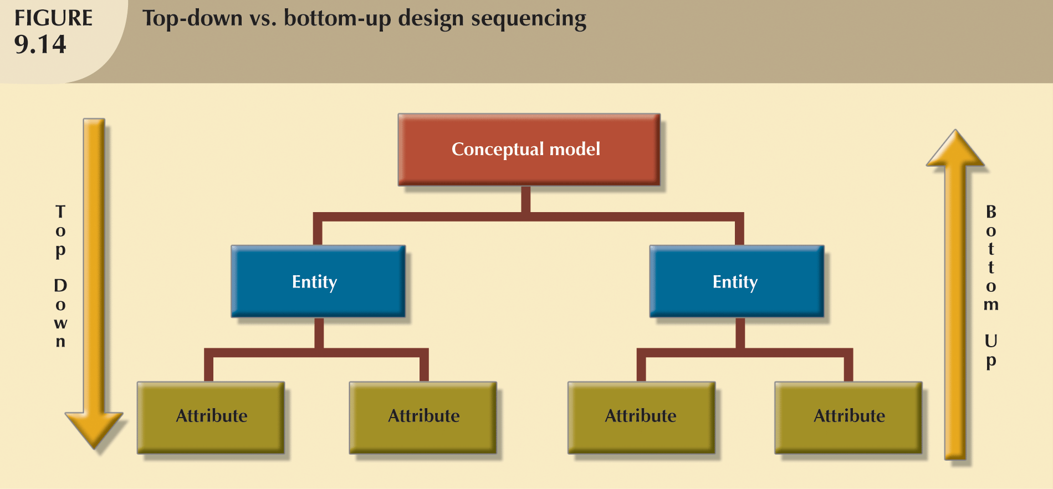
Top-Down
vs.
Bottom-Up
Design
Steps

Slide 4
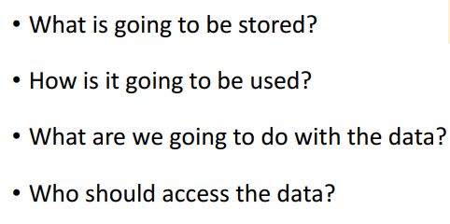
Requirement Analysis

Slide 5
Pitfalls to Avoid
Redundancy: A bad design may repeat information. For example, if we store the course identifier and title of a course with each course offering, the title would be stored redundantly (that is, multiple times, unnecessarily) with each course offering. It would suffice to store only the course identifier with each course offering, and to associate the title with the course identifier only once, in a course entity.
Incompleteness: A bad design may make certain aspects of the enterprise difficult or impossible to model. For example, suppose that, as in case (1) above, we only had entities corresponding to course offering, without having an entity corresponding to courses.

Slide 6
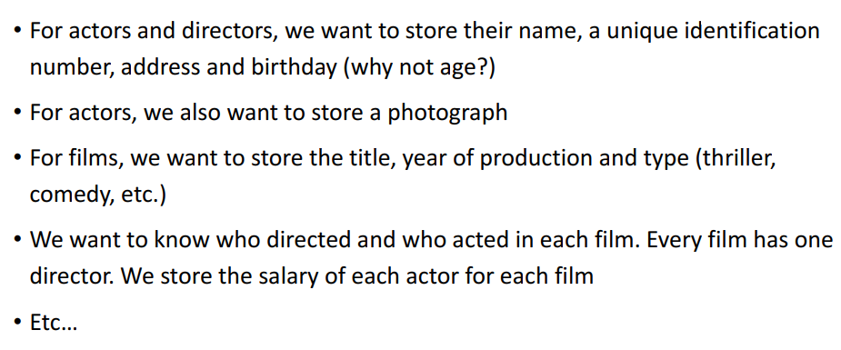
Requirement Analysis Example: IMDB

Slide 7
Entity Relationship (ER) Model
– Represents global view of data
– Main Components
Entities – things we wish to record
Attributes – properties of the things (entities), and
Relationships – connections between entities

Slide 8
Relationships
Association between entities
Connected entities are called participants Relationships between entities always operate Connectivity
▪
▪
▪
▪
in
both
directions
–
describes relationship classification
•
•
•
1:1
1:M M:N
▪
Cardinality
–
expresses number of entity occurrences associated with one
occurrence of related entity

Slide 9
Participation
The participation of an entity set E in a relationship set R is said to be total if every entity in E participates in at least one relationship in R.
If only some entities in E participate in relationships in R, the participation of entity set E in relationship R is said to be partial.

Slide 10
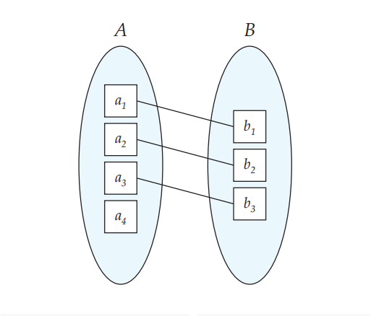
Participation

Slide 11
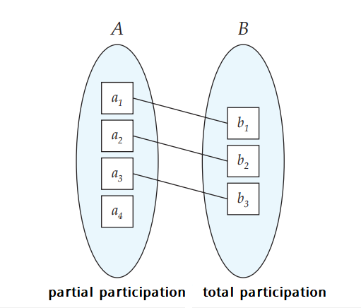
Participation

Slide 12
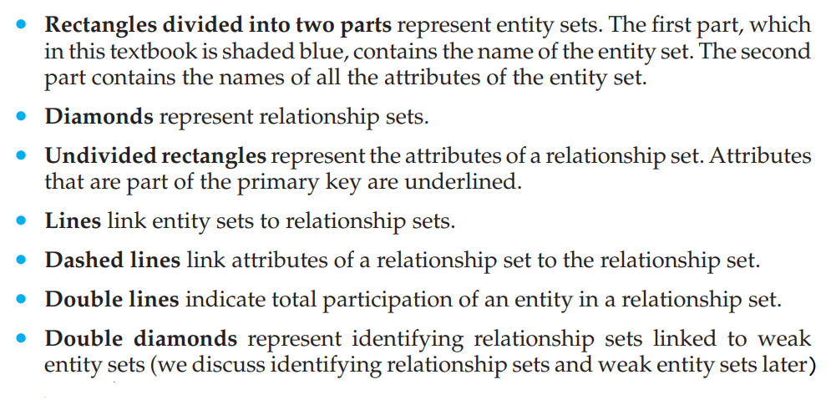
Notations

Slide 13
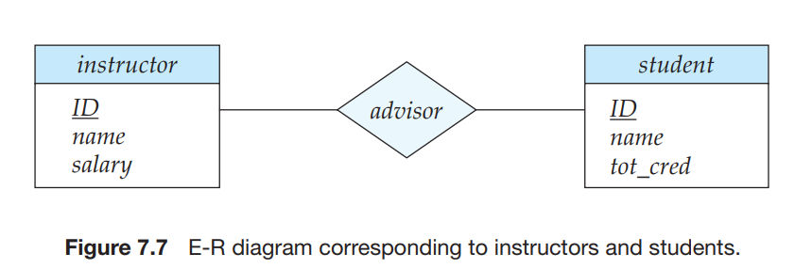
Notations

Slide 14
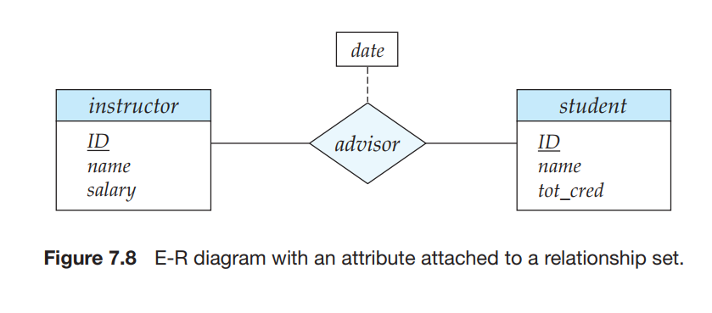
Notations
Attributes in Relationship

Slide 15
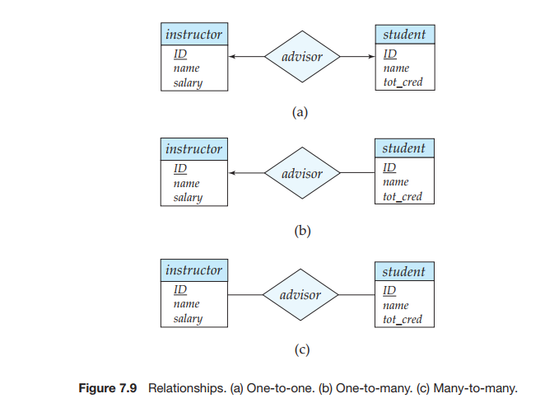
Notations
Relationships

Slide 16
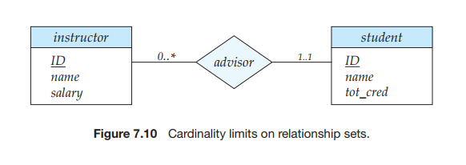
Notations
Cardinality

Slide 17
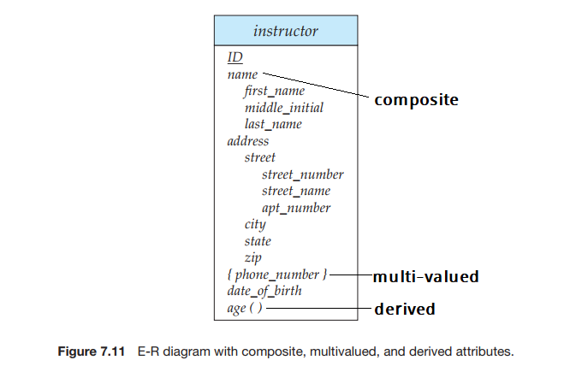
Notations
Composite, Multi-valued, and Derived Attributes

Slide 18
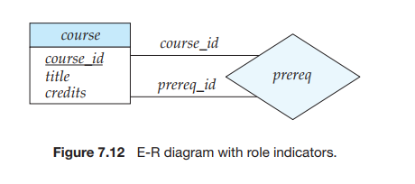
Notations
Role

Slide 19
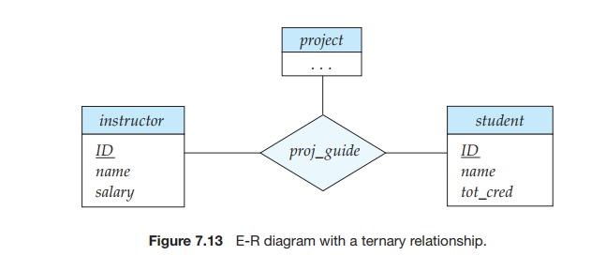
Notations
Ternary Relationship
We permit at most one arrow out of a relationship set

Slide 20
Strong and Weak Entity
An entity set that does not have sufficient attributes to form a primary key is termed a weak entity set.
An entity set that has a primary key is termed a strong entity set.

Slide 21
Strong and Weak Entity
For a weak entity set to be meaningful, it must be associated with another entity set, called the identifying or owner entity set.
Every weak entity must be associated with an identifying entity; that is, the weak entity set is said to be existence dependent on the identifying entity set.
The identifying entity set is said to own the weak entity set that it identifies.
The relationship associating the weak entity set with the identifying entity set is called the identifying relationship.

Slide 22
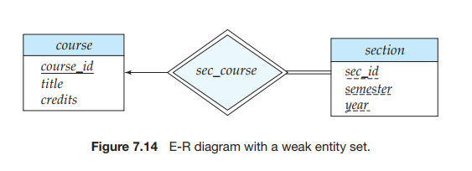
Notations
Strong and Weak Entity

Slide 23
Strong and Weak Entity
Although a weak entity set does not have a primary key, we nevertheless need a means of distinguishing among all those entities in the weak entity set that depend on one particular strong entity. The discriminator of a weak entity set is a set of attributes that allows this distinction to be made.
For example, the discriminator of the weak entity set section consists of the attributes sec id, year, and semester, since, for each course, this set of attributes uniquely identifies one single section for that course. The discriminator of a weak entity set is also called the partial key of the entity set.
The primary key of a weak entity set is formed by the primary key of the identifying entity set, plus the weak entity set’s discriminator. In the case of the entity set section, its primary key is {course id, sec id, year, semester}, where course id is the primary key of the identifying entity set, namely course, and {sec id, year, semester} distinguishes section entities for the same course.

Slide 24
Practice
Design the ER Diagram for IMDB System

